Slide 1
Computer Organization and Assembly Language
Lab 01
Introduction
Usama Bin Imran
Notes:
1

Slide 2
About me
Office: A307
Office hours – to be decided
Email: Usama.imran@isb.nu.edu.pk

Slide 3
Some Rules
Deadline of anything wouldn’t ever be extended.
No retake of assignments, quizzes, and lab tasks.
Can request a re-checking of any of your evaluation as per following rules: Assignment/Quizzes: 2 days after handing over
Exam: Same day
Attendance will not be marked if you come inside the lab after 10 minutes
Notes:
3

Slide 4
Some Rules
Submit your work on Google Classroom.
Email submissions won’t be accepted
Notes:
4

Slide 5
Dishonesty, Plagiarism
All parties involved in any kind of cheating in any exam (Quizzes, Assignments & Projects) will get negative marks.
Notes:
5

Slide 6
Tentative Evaluation Breakdown
Assignments | 10
Quizzes | 10
Project | 20
Lab tasks | 20
Final Exam | 40
Total | 100
Grading: Absolute
Notes:
6

Slide 7
Agenda for today
Why Assembly Language?
Assembler
Registers
Instructions
DOSBOX Configuration
Notes:
https://ebth-14fa.kxcdn.com/media/W1siZiIsIjIwMTQvMTAvMjAvMjEvMzAvMjcvNzQ0L1RUVF82OTg4LkpQRyJdLFsicCIsInRodW1iIiwiNzgxeDg1NVx1MDAzZSJdXQ/TTT_6988.JPG
7

Slide 8
Source code transformation into Machine Code.
Program Translation Sequence

Slide 9
Program Translation Sequence
High level language (C, C++)
Assembly Language
Machine Language
Hardware

Slide 10
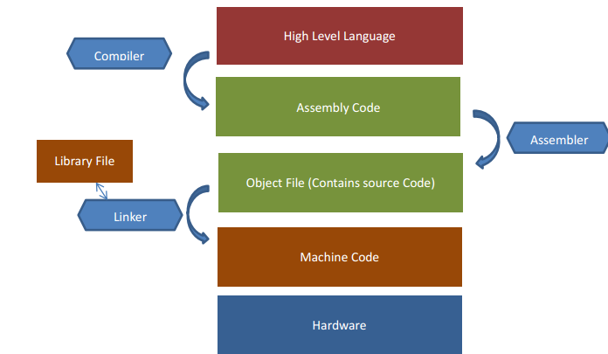
Program Translation Sequence

Slide 11
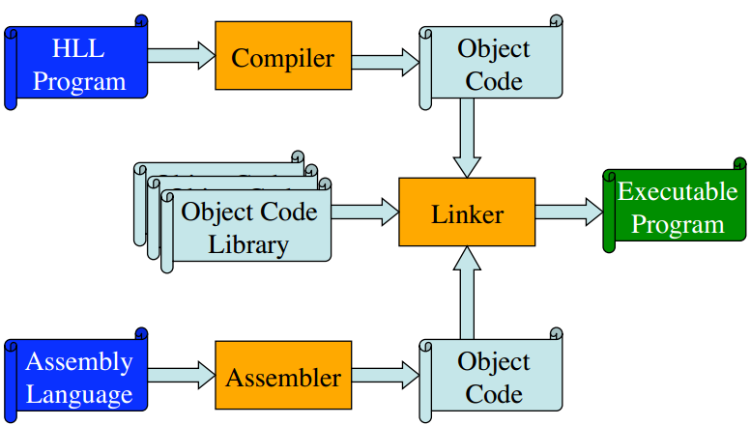
Program Translation

Slide 12
Brief Introduction to Assembler
Assembler

Slide 13
Assembler
Assembler, A program that converts source-code programs from assembly language to machine language. It generates
Object file: A machine language translation of the program.
Linker: Copies sub-routines from link library into object file & produces executable program.
Debugger: Provides a way for programmer to trace execution of a program and examine the contents of memory.

Slide 14
The Microsoft Macro Assembler (MASM) is an x86 assembler that uses the Intel syntax for Visual Studio and Microsoft Windows.

Slide 15
Visual Studio 2022

Slide 16
Installing Visual Studio
Download “Visual Studio Installer” from Google Classroom
Follow the Video guide provided on Google Classroom
https://www.loom.com/share/895449b27f4a4697acebf6e35b55904f?sid=41d8103d-f68b-4805-8c76-82c57475eb41

Slide 17
Intel 8086 (Registers)
8086 has total of Fourteen Registers accessible to programmer.
Each register is 16 bits long i.e. it can contain 16-bit binary number at max.
General Purpose/Data Registers (AX, BX, CX, DX).
Index/Pointer registers (SP, BP, SI, DI).
Segment Registers (SS, DS, SS, ES).
Control Registers (Flags, Instruction Pointer).
Notes:
17

Slide 18
Inside 8086 (Data Registers)
8086 CPU has four 16-bit data registers
AX - the accumulator register (divided into AH / AL).
BX - the base address register (divided into BH / BL).
CX - the count register (divided into CH / CL).
DX - the data register (divided into DH / DL).
These registers can be used in arithmetic or logic operations and as temporary storage.
The main purpose of a register is to keep a number (variable).
Notes:
18

Slide 19
Inside 8086 (Registers)
The size of the above registers is 16 bit, it's something like: 0011000000111001b (in binary form), or 12345 in decimal (human) form.
4 general purpose registers (AX, BX, CX, DX) are made of two separate 8 bit registers
For example if AX= 0011000000111001b, then AH=00110000b and AL=00111001b.
Registers are located inside the CPU, they are much faster than memory. accessing a memory location requires the use of a system bus, so it takes much longer.
Accessing data in a register usually takes no time. therefore, you should try to keep variables in the registers for manipulation.
Notes:
19

Slide 20
Inside 8086 (Data Registers)
Each data register has a special purpose too.
Register | Special Purpose
AX | Multiply/divide
BX | Index Registers for MOVE
CX | Count Register for String Operations
DX | Port address for IN and OUT
Notes:
20

Slide 21
Instruction
Assembler converts the instruction in to machine code.
Machine code is a sequence of bits can be read by the processor.
Tells CPU what to do.
Each instruction has
Mnemonic (Required)
Symbolic Code for Instructions or Commands to perform a particular function
mov, inc, add, sub, mul
Operand (Optional/Depend on Instruction)
On which operation is to be performed.

Slide 22
Lab Tasks
Question: Move the following values in the registers, A, B C and D and observe what values are stored in memory:
Value to be moved | Value in memory
AL, 257 | AL? AH? AX?
AX, 567 | AL? AH?
AH, 255 | AL? AX?
AL, 254 | AX?
BX, 0FF4h | BL? BH?
CX, 1237o | CL? CH?
DL, 01001001b | DL? DH?
DH, 0Ah | DL? DX?
Notes:
22

Slide 23
Lab Tasks
Question: Move the following values in the registers, A, B C and D and observe what values are stored in memory:
Value to be moved | Value in memory
AL, 25h | AL? AH? AX?
AX, 70ABh | AL? AH?
AH, 10011000b | AL? AX?
AL, 20o | AX?
BX, 11111111b | BL? BH?
CX, 1237h | CL? CH?
DL, 0FFh | DL? DH?
DH, 217 | DL? DX?
Notes:
23

Slide 24
Thank You :)

